Slide 1
HYBRID CLOUD SERVICE
Sprint 4 demo : Mar 29, 2016
-Akash Singh
-Jaison Babu
-Surekha Jadhwani
-Vignesh Shanmuganathan
Mentor: Xu(Simon) Chen

Slide 2
Project Overview
Goals
  Develop an hybrid cloud model that allows application to support data processing in either private or public or both clouds with seamless data distribution.
  Easy user configuration to identify sensitive and non-sensitive data.
  Data segregation of live twitter feed using tagging mechanism that allows distribution of data between private and public cloud.
  Performance benchmarking of data analysis jobs between private, public and hybrid cloud.

Slide 3
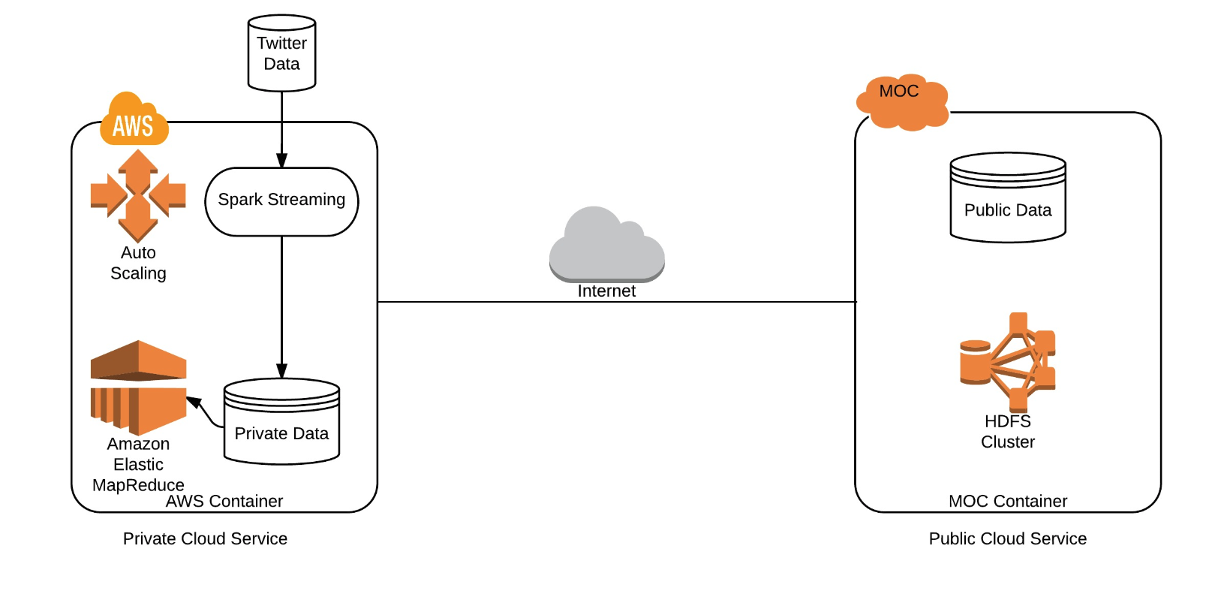
Cluster Configuration:
AWS Configuration :
MOC Configuration:
No of machines: 2
Ram: 1GB/machine
Storage: 15GB/machine
Sensitive Data: 4GB
No of machines: 5
Ram: 8GB/machine
Storage: 80GB/machine
Non-Sensitive Data: 15GB

Slide 4
Where were we standing?
Progress = 85% goals achieved and ahead of plan.
Creating a public cloud in MOC that contains non-sensitive data.
Creating a private cloud in AWS that contains sensitive data.
Set-up of Hadoop clusters in AWS and MOC.
Establishing communication between AWS and MOC for data transfers.
A spark streaming service running on AWS will gather real time data from twitter and partition data according to user configuration for classifying data as sensitive/non-sensitive. The proposed data classifiers include hash tag mechanism and linguistics.
Based on the tags/linguistics, the created classifier will distribute data across AWS and MOC.
Running jobs in the following setups:
  Running data analysis job on public cloud spanning the complete dataset (sensitive and non-sensitive data).
  Running data analysis job on private cloud spanning the complete dataset.
  Running data analysis job on non-sensitive data on public cloud and on sensitive data on private cloud, in parallel.
Performing benchmark analysis on the above proposed configurations.

Slide 5
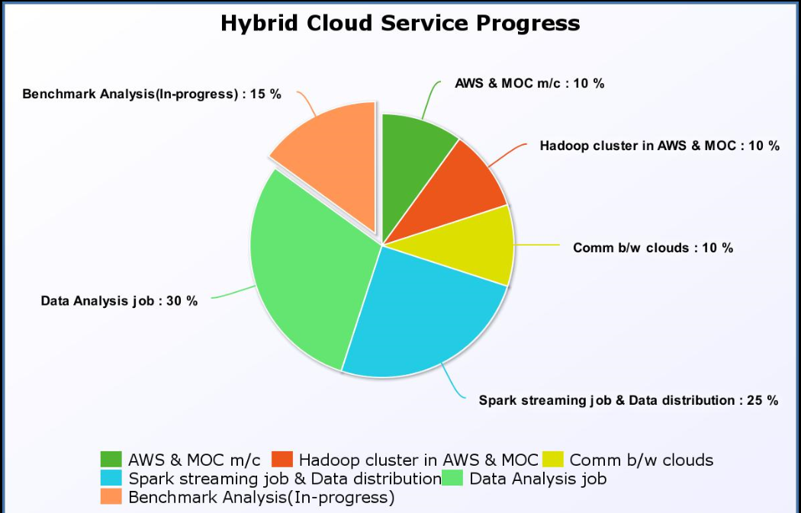
Where were we standing?(cont’d):

Slide 6
Sprint 4 : Mar 29
User story covered:
  As a user , one must be able to run spark analytical job both on Spark Hadoop AWS and MOC Cluster with performance enhancements
    Explore use cases for parallel processing of Spark Analytic jobs in MOC and AWS
    Implement use cases for parallel processing of Spark Analytic jobs in MOC and AWS
    Create benchmarking harness
    Perform analysis of analytical jobs on both private and public cloud

Slide 7
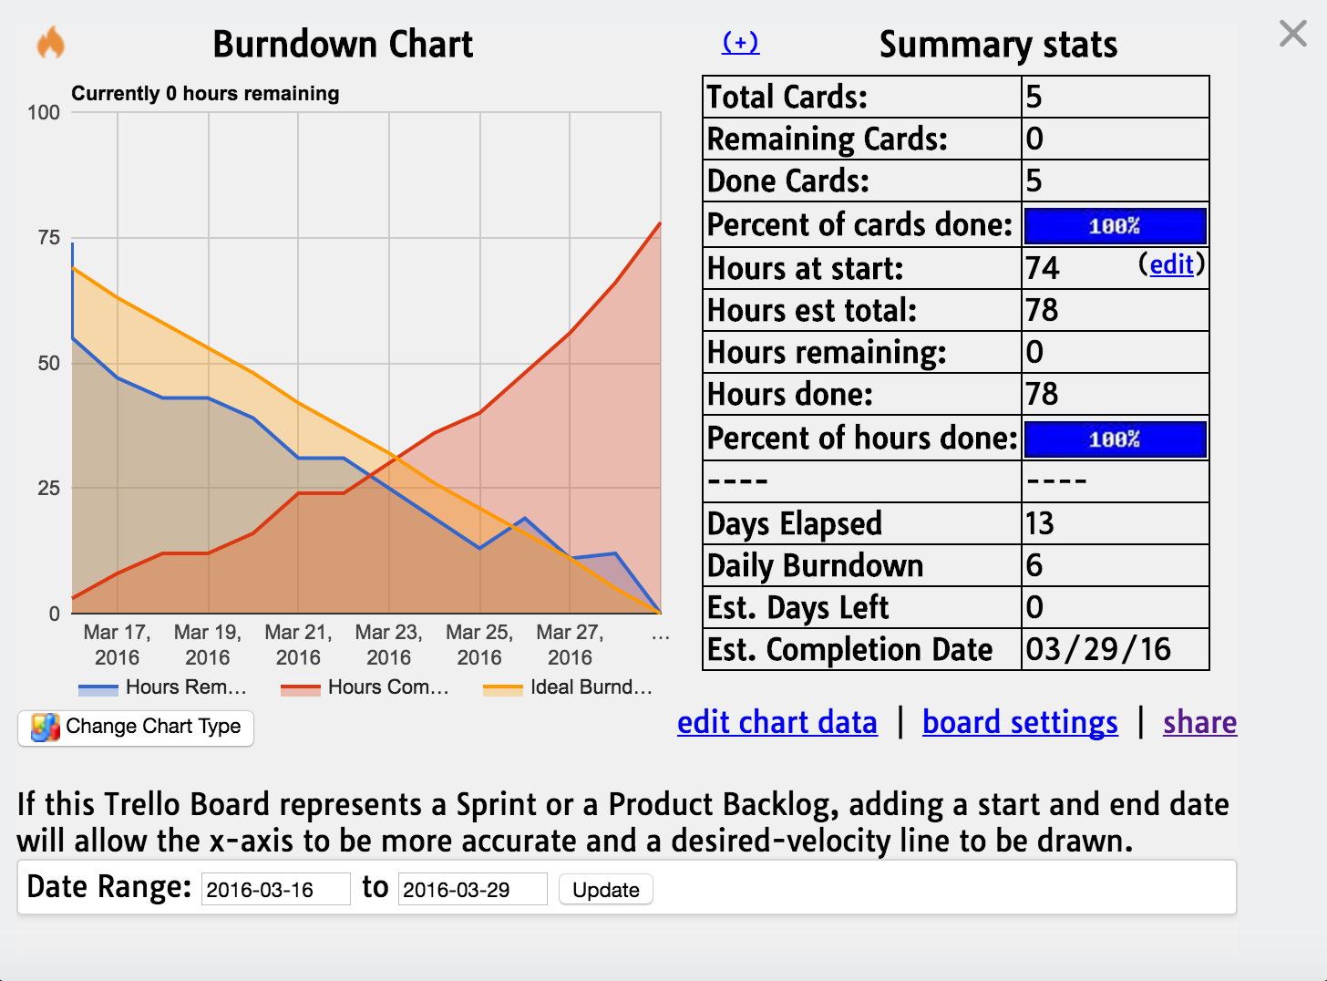
Trello Burndown:

Slide 8
Learnings from the Project:
Private cloud and public cloud set-up in AWS and MOC
Configuring HDFS in cluster mode
Learned and worked on new technologies like Spark, Hadoop MapReduce, Twitter API.
Distributed jobs such as Spark streaming, Hadoop analytics job
Allowing data communication between private and public cloud
Use of SSL layer between private and public cloud to ship the data
Task tracking tool such as Trello

Slide 9
Major Innovations:
User defined data tagging mechanism to segregate data between private and public cloud without compromising sensitive information
Secured data transfer between private and public clouds
One Auto-scaling feature (Stretch-goal, to be achieved in next sprint)

Slide 10
Plan for Sprint 5: Apr 15
User story planned:
  As a user , one must be able to run spark analytical job both on Spark Hadoop AWS and MOC Cluster with performance enhancements on large data set and consider auto scaling
    Implement other use cases for parallel processing of Spark Analytic jobs in MOC and AWS
    Perform analysis of analytical jobs on both private and public cloud using benchmarking harness
    Auto-scaling (stretch goal)

Slide 11
DEMO: https://youtu.be/SMEP5S8H3fM

Slide 12
Questions?

Slide 13
Thank You

